Slide 1

Waits, DriverUtil - 13
Orion Innovation
Company Overview

Slide 2
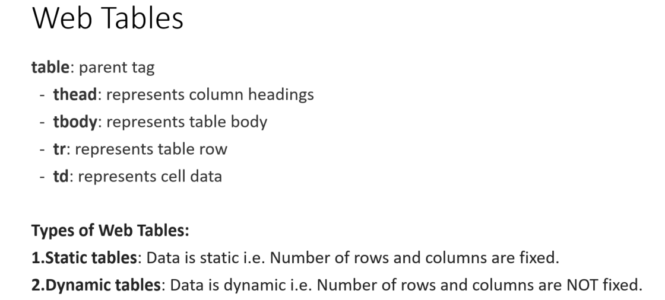
Previous Lesson’s Highlights

Slide 3
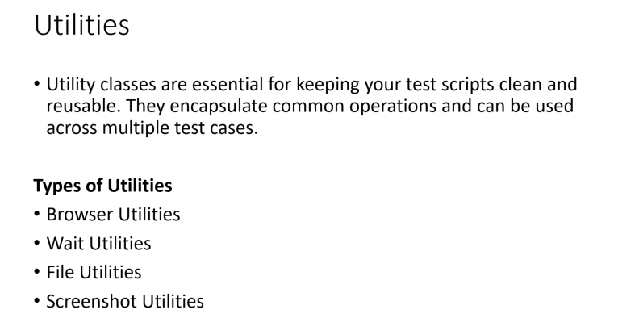
Previous Lesson’s Highlights

Slide 4
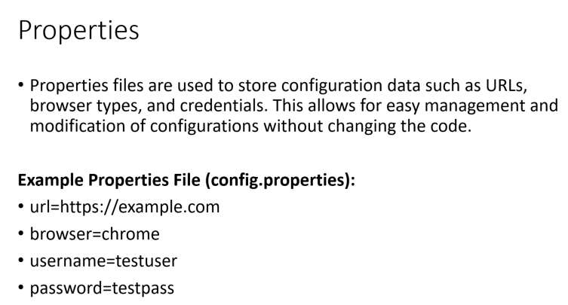
Previous Lesson’s Highlights

Slide 5
Content
Waits (Implicit Wait, Explicit Wait)
Driver Util

Slide 6
Synchronization - Selenium Waits
Synchronization is very important for UI (user interface) automation testing.
If the application server or web server is very slow, or the internet network is very slow, the element (webelement) on the web page loads very slowly.
In this case, when your test script tries to find the element, the elements do not load.
Therefore, the test script cannot find the element and fails, resulting in a “NoSuchElementException”.
To solve this problem, we need to add an extra wait for our driver to slow down.

Slide 7
Types of Waits:
Implicit Wait: A global timeout for all elements on the page.
Explicit Wait: Mostly used for a specific condition expected for certain elements.

Slide 8
Implicit Wait
The driver waits for a specific time for all elements on a page. Testers usually set the driver object to wait implicitly by default in their automation frameworks. We use implicit wait in our TestBase class.In implicit wait, there is no expected condition like clickability, visibility, etc.java

Slide 9
driver.getdriver().manage().timeouts().implicitlyWait(Duration.ofSeconds(10));
This means we want the driver to wait for 10 seconds for any element (Web Element) on the page.
If the Web Element loads in less than 10 seconds, the driver finds it and continues. For example, if the Web Element loads in 3 seconds, the driver will wait only for 3 seconds and move to the next line. If the Web Element does not load within 10 seconds, the test case will fail and give a “NoSuchElementException” warning.

Slide 10
Explicit Wait
Explicit wait is used when there is an expected condition. This is used for specific elements (Web Elements) that require more waiting time.
First, a wait object is created with a specific amount of wait time.
Creating the wait object: WebDriverWait wait = new WebDriverWait(driver, Duration.ofSeconds(10));
Using the wait object for a Web Element:
wait.until(ExpectedConditions.elementToBeClickable(element));
wait.until(ExpectedConditions.visibilityOfElementLocated(By.id("unername")));

Slide 11
Expected Conditions
1.alertIsPresent()
2.elementSelectionStateToBe()
3.elementToBeClickable()
4.elementToBeSelected()
5.frameToBeAvaliableAndSwitchToIt()
6.invisibilityOfTheElementLocated()
7.invisibilityOfElementWithText()
8.presenceOfAllElementsLocatedBy()
9.presenceOfElementLocated()
10.textToBePresentInElement()
11.textToBePresentInElementLocated()
12.textToBePresentInElementValue()
13.titleIs()
14.titleContains()
15.visibilityOf()
16.visibilityOfAllElements()
17.visibilityOfAllElementsLocatedBy()
18.visibilityOfElementLocated()

Slide 12
Introduction to Singleton Driver Class
What is Singleton Driver Class?
A class designed to control the browser and interact with web pages using Selenium WebDriver.
Ensures a single instance of the Driver object is created and shared throughout the test scenario.
Promotes efficient organization and maintenance of test scenarios.
Why Use Singleton Driver Class?
Resource Efficiency: Prevents the creation of multiple browser instances, saving memory and speeding up test execution.
Example: Like using the same fork to eat more than one dish, a single driver instance can handle all test steps.
Memory Management: Avoids memory waste from unused driver objects.

Slide 13
Singleton Driver Class
How to Implement Singleton Driver Class?
Private Static Instance: Create a private static object in the Driver Class.
Private Constructor: Prevent object creation from outside by setting the constructor as private.
Static Method: Provide a public static method to return the instance.
If the instance is already created, return the existing one.
If not, create and return the new instance.
Benefits
Efficient Memory Usage: Reuses the same driver instance, reducing memory consumption.
Faster Execution: Minimizes the time spent on opening new browser instances.
Improved Management: Simplifies the test scenario management process.

Slide 14
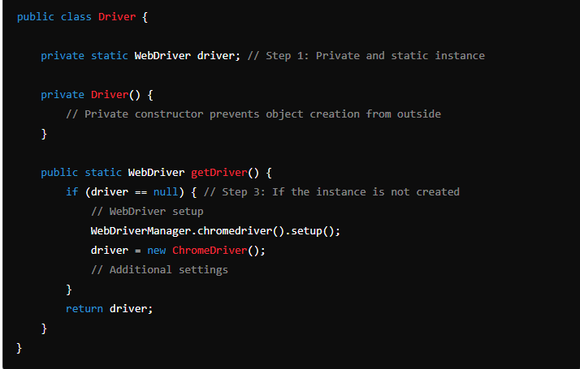
Singleton Driver Class (Java Example)

Slide 15
Thanks

